Slide 1
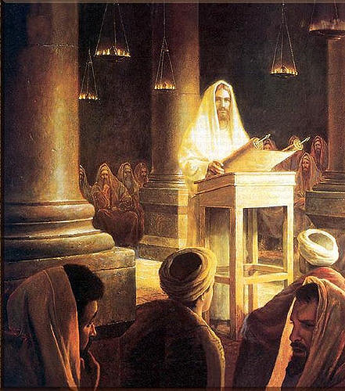
“Hard Sayings”
John 6:53-60

Slide 2

Difficult to Accept – Difficult to Apply
First one must understand what is being discussed
Must accept the fact that it is true
Then must make the personal application
Put it into practice in one’s life!

Slide 3

“Then Jesus said to them, “Most assuredly, I say to you, unless you eat the flesh of the Son of Man and drink His blood, you have no life in you. Whoever eats My flesh and drinks My blood has eternal life, and I will raise him up at the last day. For My flesh is food indeed, and My blood is drink indeed. He who eats My flesh and drinks My blood abides in Me, and I in him.”
John 6:53-56

Slide 4
“As the living Father sent Me, and I live because of the Father, so he who feeds on Me will live because of Me. This is the bread which came down from heaven – not as your fathers ate the manna and are dead. He who eats this bread will live forever. These things He said in the synagogue as He taught in Capernaum. Therefore many of His disciples, when they heard this said, This is a hard saying; who can understand it?”
John 6:57-60

Slide 5
#1. Eating His Flesh and Drinking His Blood
Not speaking of the Lord’s Supper
Make reference to “manna” in the wilderness
  Exodus 16:4
Blood was forbidden under the Old Law
  Leviticus 17:11-12
Found His words shocking and unacceptable!
Meaning???

Slide 6
Eating His Flesh and Drinking His Blood
He was the true bread of heaven
  He himself has descended from heaven to be the bread of life and give sustenance for the soul
Taking Christ into their hearts would lead to “eternal life”
Only by accepting the “blood of His sacrifice” could one find a remedy for their sins!
  Ephesians 1:7; Romans 5:9

Slide 7
“Jesus answered and said to him, ‘Most assuredly, I say to you, unless one is born again, he cannot see the kingdom of God.’
Nicodemus said to Him, ‘How can a man be born when he is old? Can he enter a second time into his mother's womb and be born?’ Jesus answered, ‘Most assuredly, I say to you, unless one is born of water and the Spirit, he cannot enter the kingdom of God.’”
John 3:3-5

Slide 8
#2. Being “Born Again” – Water and Spirit
For many this is a “hard saying.”
Not a physical birth but a “spiritual birth”
  Romans 6:1-7; Colossians 2:12
Two things impossible:
  1. Cannot see the kingdom of God
  2. Cannot enter the kingdom of God
Requires
  1. Radical change
  2.True repentance – change of conduct – 2 Corinthians 5:17

Slide 9
“The Pharisees also came to Him, testing Him, and saying to Him, ‘Is it lawful for a man to divorce his wife for just any reason?’ And He answered and said to them, ‘Have you not read that He who made them at the beginning made them male and female, and said, “For this reason a man shall leave his father and mother and be joined to his wife, and the two shall become one flesh.”’
Matthew 19:3-5

Slide 10
“’So then, they are no longer two but one flesh. Therefore what God has joined together, let not man separate.’ They said to Him, ‘Why then did Moses command to give a certificate of divorce, and to put her away?’ He said to them, ‘Moses, because of the hardness of your hearts, permitted you to divorce your wives, but from the beginning it was not so.’”
Matthew 19:6-8

Slide 11
“And I say to you, whoever divorces his wife, except for sexual immorality, and marries another, commits adultery; and whoever marries her who is divorced commits adultery.”
Matthew 19:9

Slide 12
#3. Marriage and Divorce
For many this is a “hard saying.”
God is the authority over the law of marriage
  Matthew 28:18
Two truths:
  1. Marriage is Male/Female – No same sex unions are acceptable
  2. Sexual immorality ONLY cause for divorce – not put asunder
Requires
  1. Men understand the seriousness of their choice
  2. Man’s laws and reasoning – don’t alter God’s laws!

Slide 13
“For if you forgive men their trespasses, your heavenly Father will also forgive you.
But if you do not forgive men their trespasses, neither will your Father forgive your trespasses.”
Matthew 6:14,15

Slide 14
“Bearing with one another, and forgiving one another, if anyone has a complaint against another; even as Christ forgave you, so you also must do.”
Colossians 3:13

Slide 15
#4. Forgiveness Of Others
For many this is a “hard saying.”
God spoke with authority
  Matthew 7:28-29
Two truths:
  1. Not willing to forgive others – no forgiveness from God!
  2. One can be morally right – but still be lost!
Examples
  1. God forgiving David – 2 Samuel 12:7-13; Acts 13:22
  2. Saul’s hatred for Christians – Acts 9:12-16/Galatians 1:15

Slide 16

Difficult to Accept – Difficult to Apply
One can understand what is being discussed
Can accept the fact that it is true
Then makes the personal application
Begin to practice in one’s life!

